Slide 1
Driving Center
Company Profile Infographics
Here is where this template begins

Slide 2
About Driving center company profile infographics
This template contains an assortment of complementary infographic resources for the Driving Center presentation.
These infographics are adapted to the style of the aforementioned presentation, so you can insert them easily and have them completely integrated at once. You just need to do the following:
Select the element that you want to copy
Right-click and choose “Copy”
Go to the slide where you want the element to appear
Right-click and choose “Paste”
You can delete this slide when you’re done editing the presentation.

Slide 3
Driving center company profile infographics
OIL
Jupiter is a gas giant and the biggest planet
ENGINE
Neptune is very far away from Earth
FAN
Mercury is the closest planet to the Sun
BATTERY
Despite being red, Mars is a cold place

Slide 4
Driving center company profile infographics
STEP 1
STEP 2
STEP 3
TRACTION VEHICLE
ONE-WAY STREET
DRIVING LICENSE
Jupiter is a gas giant and the biggest planet
Mercury is the closest planet to the Sun
Neptune is very far away from Earth

Slide 5
Driving center company profile infographics
STRATEGY ROADMAP
Q1 | Q2 | Q3 | Q4
 |  |  |  | TRAFFIC
 |  |  |  | ROAD SIGNS
 |  |  |  | CROSSWALKS
 |  |  |  | PARKING
 |  |  |  | PEDESTRIANS

Slide 6
Driving center company profile infographics
01
THEORY
02
Venus has a really beautiful name
INSTRUCTION
03
Jupiter is the biggest planet of them all
TEST
04
Saturn is a planet with several rings
LICENSE
Earth is the third planet from the Sun

Slide 7
Driving center company profile infographics
01
02
VENUS
JUPITER
Venus has a really beautiful name
Jupiter is the biggest planet
03
04
SATURN
EARTH
Saturn is a planet with several rings
Earth is the third planet from the Sun
05
06
NEPTUNE
MARS
It’s the farthest planet from the Sun
Mars is actually a very cold place

Slide 8
Driving center company profile infographics
ATTENTION!
DON’T DRINK
NO PHONE
CAR CHECK
Venus has a really beautiful name
Jupiter is the biggest planet of them all
Saturn is a planet with several rings

Slide 9
Driving center company profile infographics
WHAT TO DO IN CASE OF AN ACCIDENT
01 | STOP THE CAR | Mercury is very small
02 | CALL THE POLICE | Venus is very hot
03 | TAKE PHOTOS | We all live on Earth
04 | DESCRIBE THE ACCIDENT | Mars is a red planet
05 | FIND WITNESSES | Jupiter is a big planet
06 | CALL A LAWYER | Saturn has beautiful rings

Slide 10
Driving center company profile infographics
DOS
DON’TS
Jupiter is a gas giant and the biggest planet
Mercury is the closest planet to the Sun
Venus is the second planet from the Sun
Earth is the third planet from the Sun
Neptune is the farthest planet from the Sun
Despite being red, Mars is a cold place
Saturn is a gas giant and has several rings
Ceres is located in the main asteroid belt

Slide 11
Driving center company profile infographics
01
MECHANICAL CHECK
Venus has a beautiful name
02
VISUAL INSPECTION
Jupiter is the biggest planet
03
VEHICLE HISTORY
Saturn is a planet with rings

Slide 12
Driving center company profile infographics
50%
75%
25%
LIGHT BULBS
HEADLIGHTS
TURN SIGNALS
Jupiter is a gas giant and the biggest planet
Mercury is the closest planet to the Sun
Venus is the second planet from the Sun

Slide 13
Driving center company profile infographics
HOW TO CHANGE A TYRE
01
02
03
PLACE JACK
REMOVE NUTS
SLIDE WHEEL
Venus has a really beautiful name
Jupiter is the biggest planet of them all
Saturn is a planet with several rings

Slide 14
Driving center company profile infographics
HOW TO CHANGE A TYRE
04
05
06
SET ASIDE
SPARE TYRE
SCREW NUTS
Venus has a really beautiful name
Jupiter is the biggest planet of them all
Saturn is a planet with several rings

Slide 15
Driving center company profile infographics
DRIVING CENTER |  | FIRST PAYMENT | SECOND PAYMENT | THIRD PAYMENT
 | THEORY | $1,000 | $2,000 | $2,000
 | PRACTICE | $1,000 | $1,500 | $3,000
 | TEST | $200 | $250 | $300

Slide 16
Driving center company profile infographics
A
REARVIEW MIRROR
Venus has a beautiful name
A
B
DRIVER MIRROR
B
Jupiter is the biggest planet
C
BLIND POINT
C
Saturn is a planet with rings

Slide 17
Driving center company profile infographics
TEST
Mercury is the closest planet to the Sun
DRIVING LICENSE
PRACTICE
THEORY
Jupiter is the biggest planet of them all
Despite being red, Mars is a cold place

Slide 18
Driving center company profile infographics
FAILED
20%
Venus has a really beautiful name
PASSED
80%
Saturn is a planet with several rings

Slide 19
Driving center company profile infographics
JAN | FEB | MAR | APR | MAY | JUN | JUL | AUG | SEP | OCT | NOV | DEC
THEORY
PRACTICE
TEST
Mercury is the closest planet to the Sun
Despite being red, Mars is a cold place
Jupiter is a gas giant and the biggest planet

Slide 20
Driving center company profile infographics
CENTER 1
Jupiter is the biggest planet of them all
CENTER 2
Despite being red, Mars is a cold place
CENTER 3
Mercury is the closest planet to the Sun

Slide 21
Driving center company profile infographics
THEORY
Jupiter is a gas giant and the biggest planet
TEST
Neptune is very far away from Earth
PRACTICE
Mercury is the closest planet to the Sun
LICENSE
Despite being red, Mars is a cold place

Slide 22
Driving center company profile infographics
MOST REQUESTED
01
CLASS D
Neptune is very far away from Earth
02
CLASS E
Mercury is the closest planet to the Sun
03
JUNIOR LICENSE
Despite being red, Mars is a cold place

Slide 23
Driving center company profile infographics
JANUARY
Mon | Tue | Wed | Thu | Fri | Sat | Sun
 |  |  |  |  | 01 | 02
03 | 04 | 05 | 06 | 07 | 08 | 09
10 | 11 | 12 | 13 | 14 | 15 | 16
17 | 18 | 19 | 20 | 21 | 22 | 23
24 | 25 | 26 | 27 | 28 | 29 | 30
31
01
02
CLASS A TEST
CLASS E TEST
Jupiter is a gas giant and the biggest planet
Mercury is the smallest planet of them all

Slide 24
Driving center company profile infographics
BASIC | PRO | PREMIUM | VIP
$1,215 | $2,225 | $2,995 | $3,995
Mercury is quite a small planet | Despite being red, Mars is a cold place | Saturn is a gas giant and has rings | Neptune is very far away from us

Slide 25
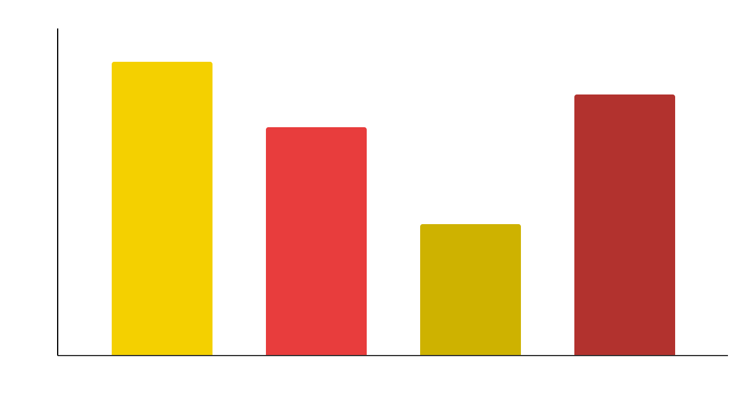
Driving center company profile infographics
CAR TUNING ESSENTIALS
Mercury is the closest planet to the Sun and the smallest one in the entire Solar System
90%
70%
40%
80%
Follow the link in the graph to modify its data and then paste the new one here. For more info, click here

Slide 26
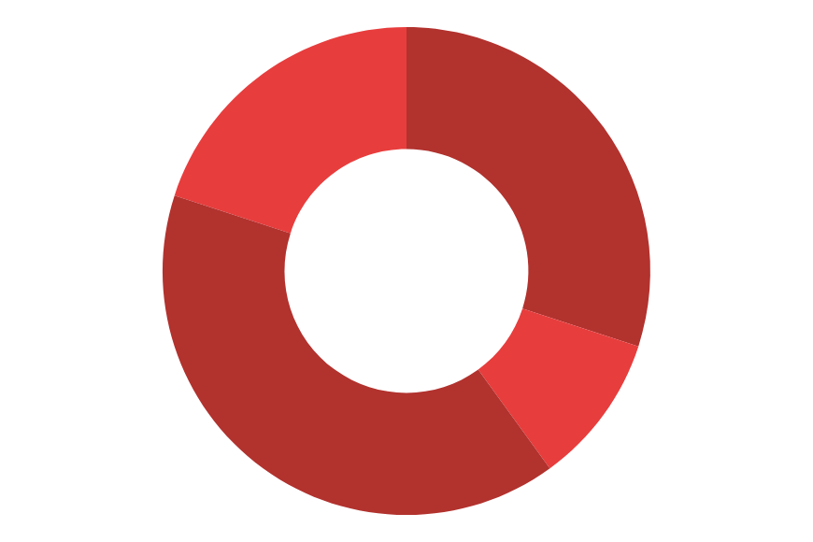
Driving center company profile infographics
Mercury is the closest planet to the Sun
Despite being red, Mars is a cold place
TRAFFIC SIGNS
DRIVING SKILLS
LICENSE
Jupiter is the biggest planet of them all
Earth is the third planet from the Sun
SENSE OF DIRECTION
MECHANICAL KNOWLEDGE
Follow the link in the graph to modify its data and then paste the new one here. For more info, click here

Slide 27
Driving center company profile infographics
VALVES
ENGINE BLOCK
Earth harbors life
TIMING BELT
OIL PAN
ENGINE PARTS
CHAMBER
Mars is very cold
SPARK PLUGS
PISTON
PISTON RING
Neptune is far away
CYLINDER

Slide 28
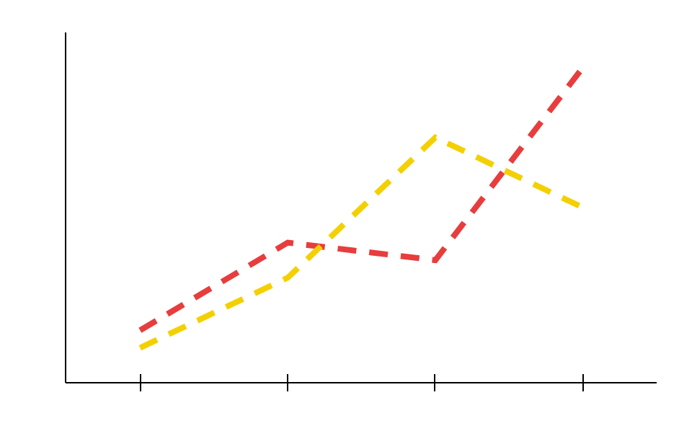
Driving center company profile infographics
CAR LICENSES
80%
Jupiter is a gas giant and the biggest planet
TRUCK LICENSES
50%
Pluto is considered a dwarf planet
Follow the link in the graph to modify its data and then paste the new one here. For more info, click here

Slide 29
Driving center company profile infographics
DRIVING INSTRUCTORS
GROUP A
GROUP B
Randy Pitman
Mercury is the closest planet to the Sun and the smallest one in the entire Solar System
Tony Sanchez
Benjamin Lean
Joann Kite
Dawn Murphy
Susan Tate
Rita Mendoza
Hazel Currey

Slide 30
Driving center company profile infographics
DRIVING LESSONS
Jupiter is the biggest planet of them all
THEORY
PRACTICE
MARS
MERCURY
VENUS
SATURN
Despite being red, Mars is a cold place
Mercury is the closest planet to the Sun
Venus is the second planet from the Sun
Saturn is a gas giant and has several rings

Slide 31
Driving center company profile infographics
01
02
CHARGING SYSTEM FUNCTIONING
CHARGING SYSTEM PROBLEMS
Jupiter is a gas giant and the biggest planet in the Solar System
Venus has a nice name and is the second planet from the Sun

Slide 32
Driving center company profile infographics
01
CAR
Jupiter is the biggest planet in the Solar System
40%
80%
02
03
TRUCK
MOTORCYCLE
Mercury is the closest planet to the Sun
Earth is the only planet that harbors life
10%

Slide 33
Instructions for use
If you have a free account, in order to use this template, you must credit Slidesgo in your final presentation. Please refer to the next slide to read the instructions for premium users.
As a Free user, you are allowed to:
- Modify this template.
- Use it for both personal and commercial projects.
You are not allowed to:
- Sublicense, sell or rent any of Slidesgo Content (or a modified version of Slidesgo Content).
- Distribute Slidesgo Content unless it has been expressly authorized by Slidesgo.
- Include Slidesgo Content in an online or offline database or file.
- Offer Slidesgo templates (or modified versions of Slidesgo templates) for download.
- Acquire the copyright of Slidesgo Content.
For more information about editing slides, please read our FAQs or visit Slidesgo School:
https://slidesgo.com/faqs and https://slidesgo.com/slidesgo-school

Slide 34
Instructions for use (premium users)
As a Premium user, you can use this template without attributing Slidesgo.
You are allowed to:
Modify this template.
Use it for both personal and commercial purposes.
Hide or delete the “Thanks” slide and the mention to Slidesgo in the credits.
Share this template in an editable format with people who are not part of your team.
You are not allowed to:
Sublicense, sell or rent this Slidesgo Template (or a modified version of this Slidesgo Template).
Distribute this Slidesgo Template (or a modified version of this Slidesgo Template) or include it in a database or in any other product or service that offers downloadable images, icons or presentations that may be subject to distribution or resale.
Use any of the elements that are part of this Slidesgo Template in an isolated and separated way from this Template.
Register any of the elements that are part of this template as a trademark or logo, or register it as a work in an intellectual property registry or similar.
For more information about editing slides, please read our FAQs or visit Slidesgo School:
https://slidesgo.com/faqs and https://slidesgo.com/slidesgo-school

Slide 35
Infographics
You can add and edit some infographics to your presentation to present your data in a visual way.
Choose your favourite infographic and insert it in your presentation using Ctrl C + Ctrl V or Cmd C + Cmd V in Mac.
Select one of the parts and ungroup it by right-clicking and choosing “Ungroup”.
Change the color by clicking on the paint bucket.
Then resize the element by clicking and dragging one of the square-shaped points of its bounding box (the cursor should look like a double-headed arrow). Remember to hold Shift while dragging to keep the proportions.
Group the elements again by selecting them, right-clicking and choosing “Group”.
Repeat the steps above with the other parts and when you’re done editing, copy the end result and paste it into your presentation.
Remember to choose the “Keep source formatting” option so that it keeps the design. For more info, please visit Slidesgo School.

